Slide 1

Installation
JDK – Java Development Kit
GIT – Code versioning
Eclipse – IDE (Integrated Development Environment)

Slide 2
JDK
Java DEVELOPMENT Kit
Not just the JRE that non-programmers use
Will allow you to create and compile Java programs, rather than just run then
There are different Java version, we will use the newest standard Java – Java8 SE

Slide 3
JDK Install
http://www.oracle.com/technetwork/java/javase/downloads/jdk8-downloads-2133151.html
Accept the license agreement
Download the correct version for your machine (probably windows-x64, i.e. Windows 64 bit)

Slide 4
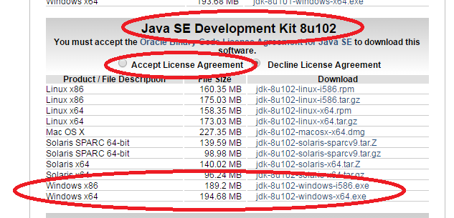
JDK Install

Slide 5
JDK Install

Slide 6
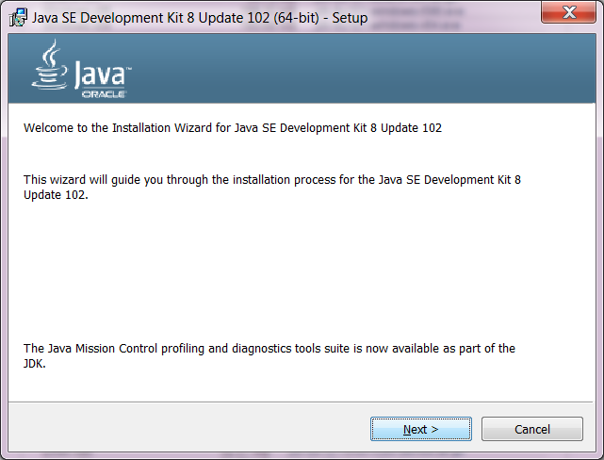
JDK Install
Run the program, and
Click “Next >”

Slide 7
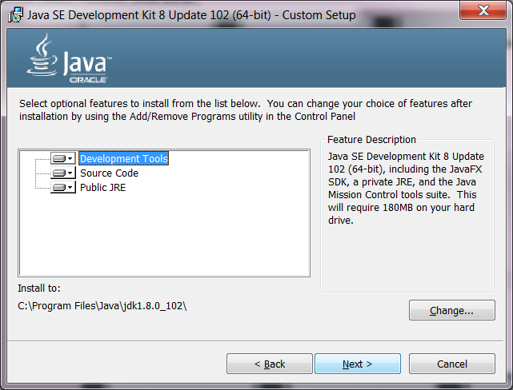
JDK Install
Click “Next >”

Slide 8
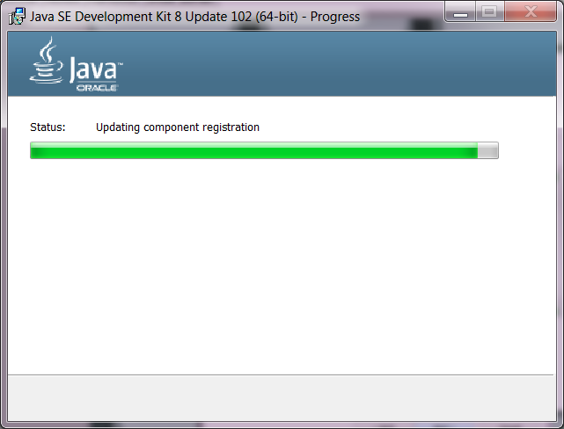
JDK Install
Wait about 30 seconds

Slide 9
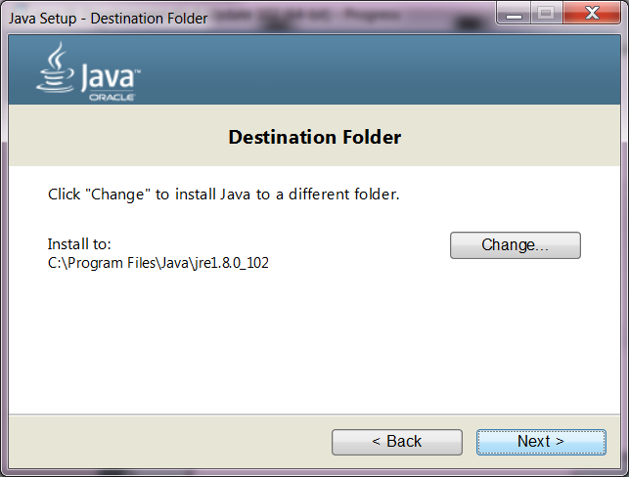
JDK Install
Click “Next >”

Slide 10
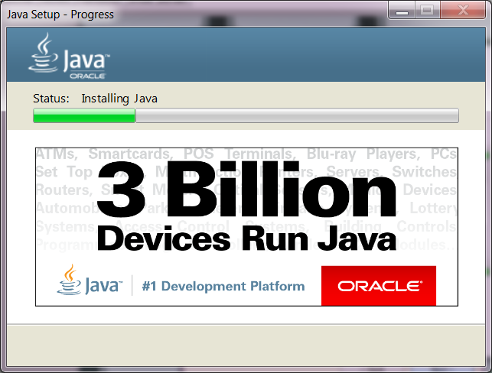
JDK Install
Become the 3,000,000,001 install

Slide 11
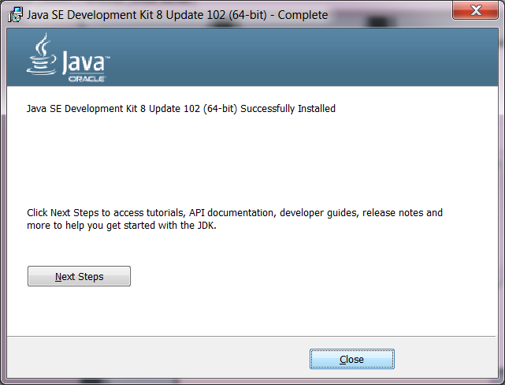
JDK Install
Click “Close”

Slide 12
GIT
Will allow you to share code
You will BRANCH the current code
Make your changes
COMMIT your code to GIT (which will be a new version of the code)
Then PUSH the code to a shared server for other to access

Slide 13
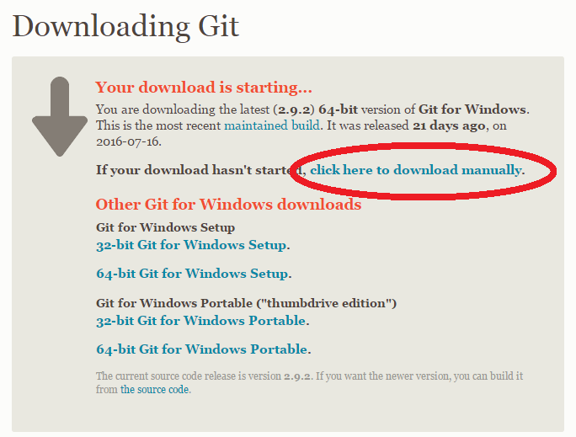
GIT Install
https://git-scm.com/download/win

Slide 14
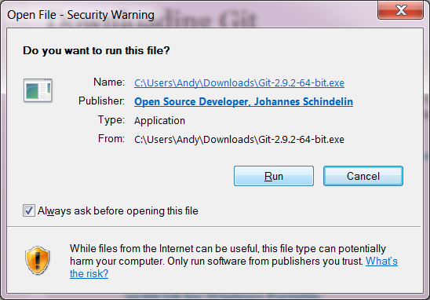
GIT Install
Click “Run”

Slide 15
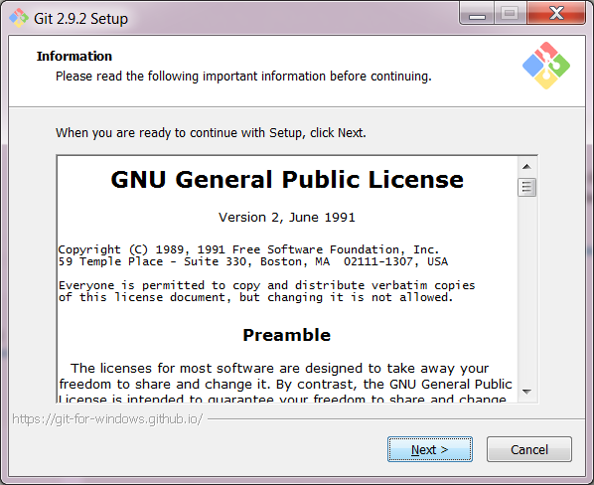
GIT Install
Click “Next >”

Slide 16
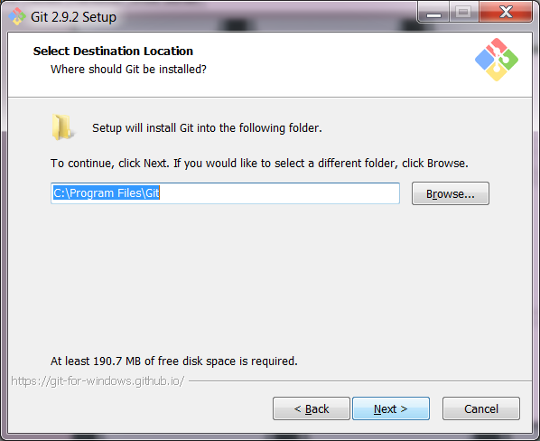
GIT Install
Click “Next >”

Slide 17
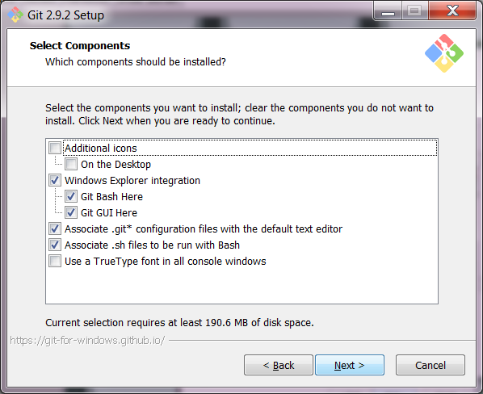
GIT Install
Click “Next >”

Slide 18
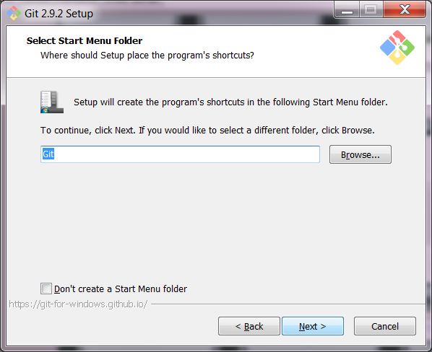
GIT Install
Click “Next >”

Slide 19
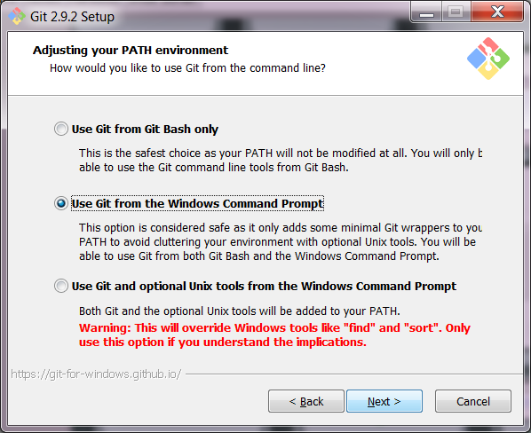
GIT Install
Click “Next >”

Slide 20
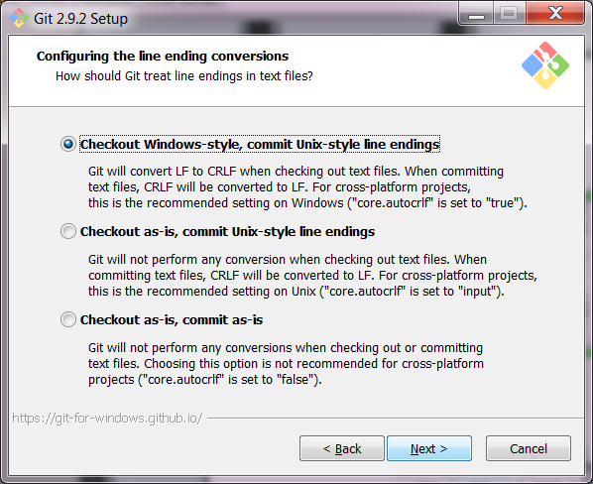
GIT Install
Click “Next >”

Slide 21
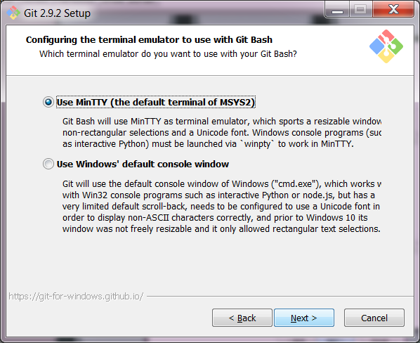
GIT Install
Click “Next >”

Slide 22
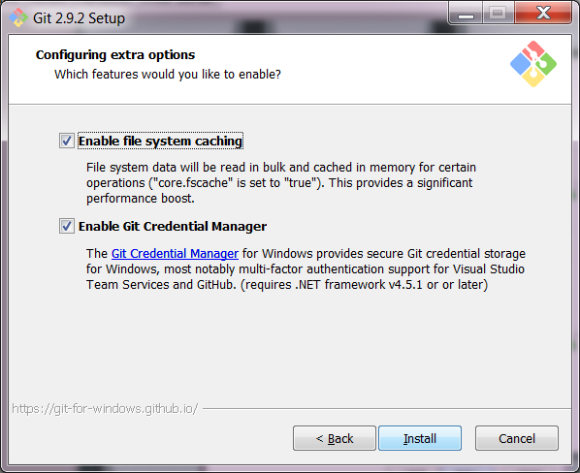
GIT Install
Click “Install”

Slide 23
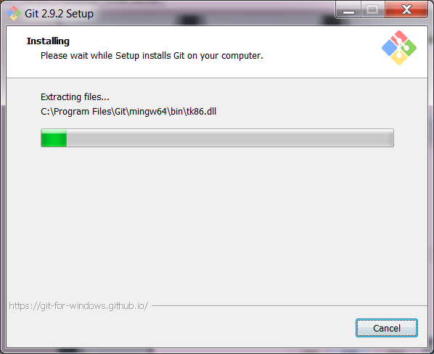
GIT Install
Wait about 30 seconds

Slide 24
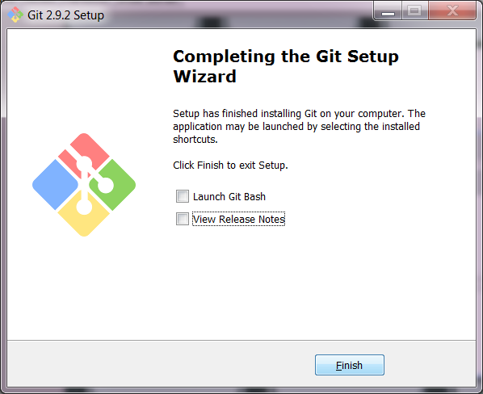
GIT Install
Uncheck “View Release Notes”
Click “Finish”

Slide 25
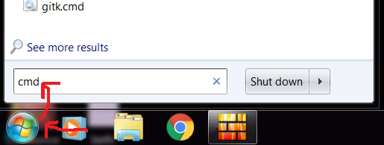
GIT Install
Click Window's Start button
Then enter “cmd” and press Enter

Slide 26
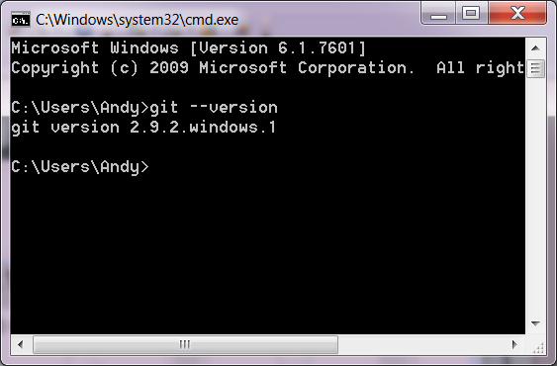
GIT Install
Type “git --version” and press Enter

Slide 27
Eclipse
A free IDE – Integrated Development Environment
All of the tools you need to develop computer programs in one package
Much easier than developing in Notepad
https://www.eclipse.org/downloads/eclipse-packages/

Slide 28
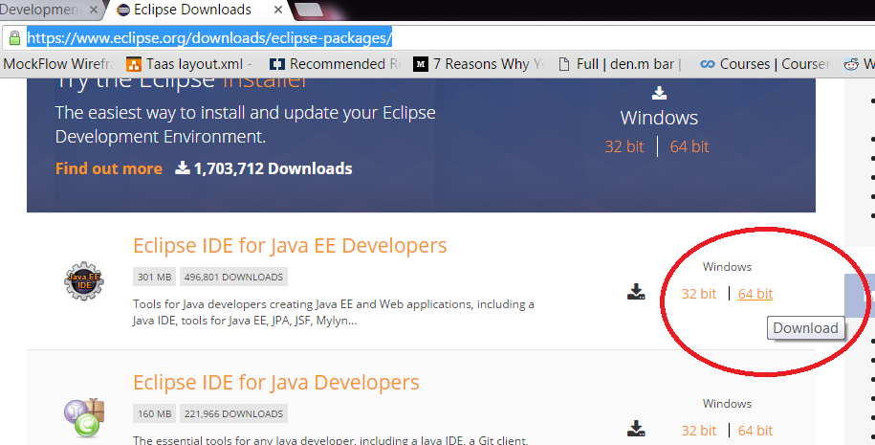
Eclipse Install
Download Eclipse IDE for Java EE Developers (that's you now)

Slide 29
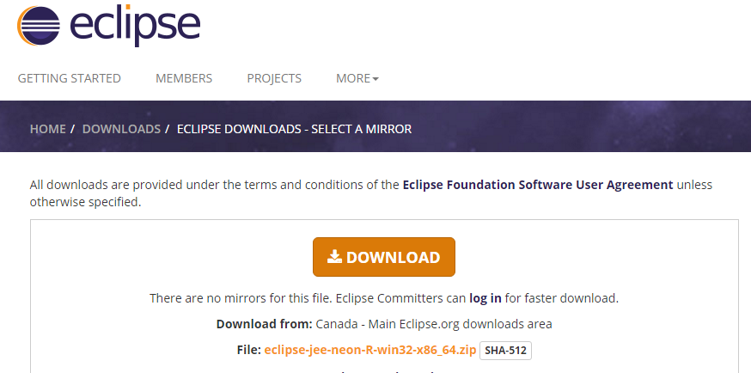
Eclipse Install
Download

Slide 30
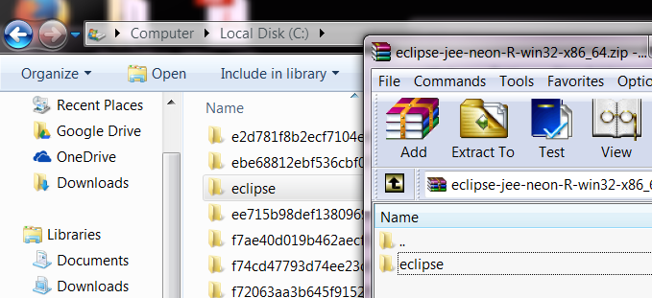
Eclipse Install
Open the zip and extract it to c:

Slide 31
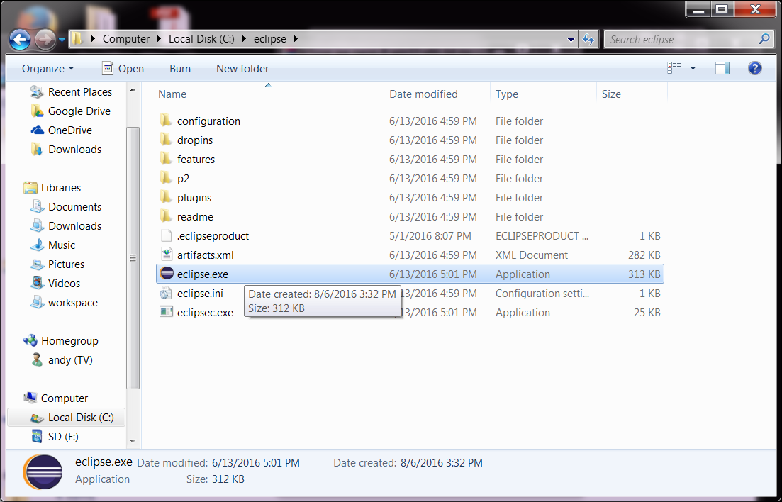
Eclipse Install
Run eclipse.exe

Slide 32
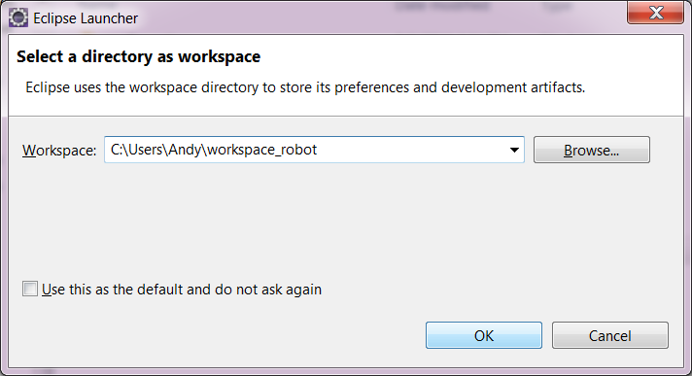
Eclipse Install
Chose the directory where you want Eclipse to save your Java files and click “OK”

Slide 33
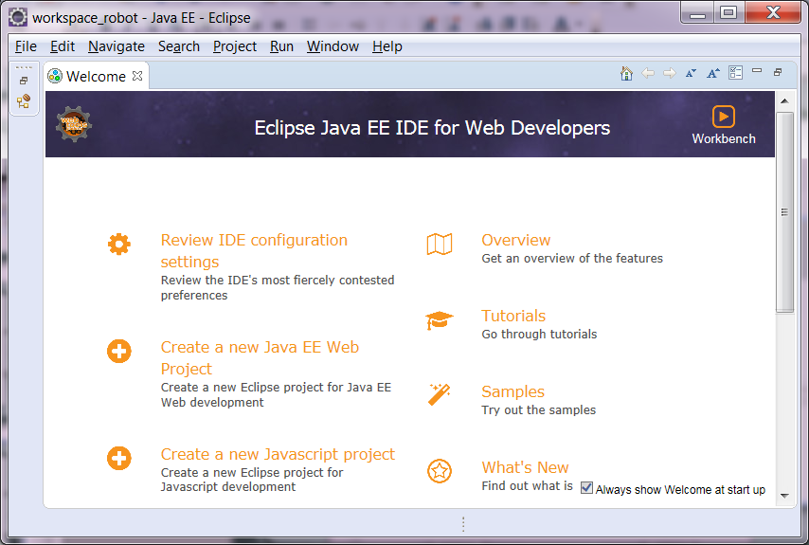
Ready To Go!

